Slide 1

Kohinoor Maple Leaf Cement
Faheel Ahmed
Moiz Shaikh
Hassan Zahid
Imran Sadiq
Ahsan Ishtiaq
Syed Haider Ali

Slide 2

History
1956 → established through a joint collaboration between government of Canada and the West Pakistan Industrial Development Corporation.
1992 → privatized and transferred to Kohinoor Group forming Kohinoor Maple Leaf Group (KMLG) which is owned by Saigol group of companies.
1994 → got listed on all three stock exchanges of Pakistan.
Undertook expansion in 2005 and 2007.

Slide 3
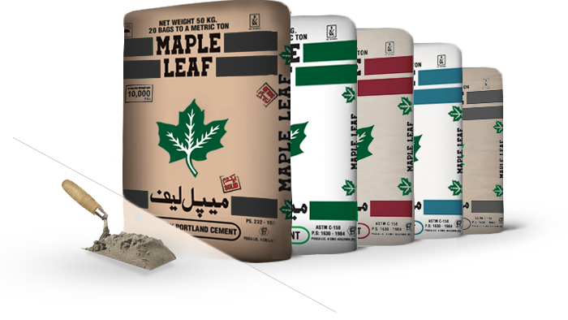
Product Portfolio
Grey Cement (Ordinary Portland Cement)
Sulphate Resistant Cement (SRC)
Low Alkali Cement
Wall Coat
White Cement

Slide 4

Clientele
The product is primarily used for construction of residences.
Products have also been used for the purposes of construction of airports, runways, dams, barrage, highways and motorways.

Slide 5
SWOT Analysis
Strengths High quality products along with strong customer relations. Skilled management. Strong values. | Weaknesses Lack of spare production capacity. Expensive Products. Limited market due to high transportation costs.
Opportunities Increasing local demand for cement.(CPEC) Automation of departments by using new technology. Rising export market for cement. | Threats Increasing number of local competitors. Threat of new entrants. Rising Oil prices.

Slide 6
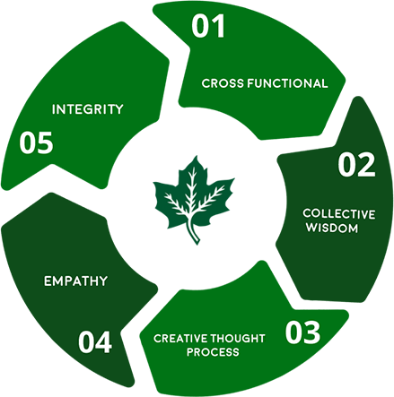
Core Values

Slide 7

Corporate and Competitive Strategy
Maple Leaf Cement manufacture and market different types of consistently high quality cement, according to the demanding requirements of the construction industry.
Their strategy is to be competitive in the market through quality and efficient operations.
As a responsible member of the community, the company is committed to serve the interest of their stakeholders and contribute towards the prosperity of the Country.

Slide 8
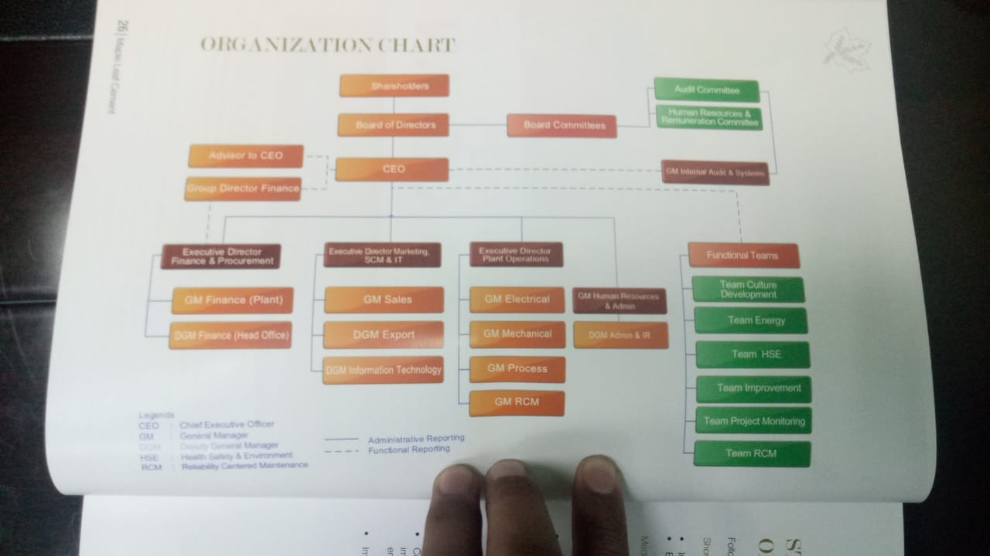

Slide 9

Organizational Design and Structure
Kohinoor Maple Leaf Cement has an organizational structure which depicts high levels of differentiation.
The organization has then been departmentalized around specialized activities namely Finance & Procurement, Marketing, Supply Chain Management etc.
The organization also places a lot of focus on cross functionality.
The organization is a centralized one where important strategic decisions concerning the organization are undertaken by the top management.
The organization encourages employees at all levels to develop ideas that can help improve its processes.
Managers at the company have an open-door policy.

Slide 10

Corporate Social Responsibility
Kohinoor Maple Leaf Group (KMLG) claims to be a responsible member of the society and believes in giving back to the society
It has undertaken various projects in pursuance of this aim such as construction of waste heat recovery plant to reduce energy costs and adverse environmental effects.
It has also made efforts to promote education in the country.
Establishment of Chandbagh School in Muridkee
Sayeed Saigol Auditorium at LUMS
Saigol House at Aitchison College Lahore
Donations to the health sector consist of the Oncology Centre at Agha Khan Hospital, Karachi, Shaukat Khanum and the Sayeed Saigol Cardiac Complex at the Gulab Devi Chest Hospital, Lahore.

Slide 11
Analysis and Recommendation

